Slide 1

CIRO’s New OEO Guidance: Potential Opportunities
A Deloitte Perspective
October 2025

Slide 2

Table of Contents
Executive Summary
1
Regulatory Context & Market Implications
2
Interpretation of Proposed Guidance
3
Path Forward
4

Slide 3
1. Executive Summary

Slide 4
Executive Summary
CIRO’s Proposed Guidance unlocks new opportunities for Order Execution Only (OEO) Dealers to deliver enhanced decision-making supports, create end-to-end investor journeys, and gain a competitive edge in the DIY investing space
CIRO is proposing to replace its 2021 OEO Guidance with a new principle-based framework that introduces a narrower definition of ‘recommendation’, flexibility on ‘push’ vs. ‘pull’ distinction, and explicit allowance for self-assessment tools
CIRO’s move aligns with global regulatory trends, setting the stage for greater flexibility in the future and creating an opening for OEO Dealers (‘OEOs’) to lead with differentiated decision-making supports while managing channel conflict
The guidance enables OEOs to roll out enhanced tools, including personalized alerts & notifications, contextual educational content, and integrated self-assessment modules that can support investors without crossing into advice
These supports can be orchestrated into end-to-end investor journeys, enabling OEOs to meet the full spectrum of DIY investing needs – from learning and goal setting to portfolio construction and ongoing monitoring
OEOs that act now will shape the market, defining what ‘good’ looks like under the new framework, while firms that wait risk falling behind as investor expectations evolve and competitors move quickly to deploy differentiated experiences

Slide 5
2. Regulatory Context & Market Implications

Slide 6



Evolving Regulatory Approach
In response to the rapid growth of DIY investing, CIRO is updating its guidance to provide OEO Dealers with greater flexibility to better service DIY investors’ needs without compromising the recommendation prohibition
  Background
  CIRO’s Rationale for Proposed Guidance
  The Canadian Investment Regulatory Organization (CIRO) is proposing to replace its current Order Execution Only (OEO) guidance (Guidance Note 3400-21-003, issued in March 2021, referred to as the ‘Current Guidance’) with a new, principle-based framework (referred to as the ‘Proposed Guidance’)
  The Proposed Guidance clarifies the prohibition on recommendations in OEO accounts and consequently broadens the scope of decision-making supports that OEO Dealers (‘OEOs’) can offer investors
  CIRO is accepting comments on the Proposed Guidance until November 2025
  The finalized guidance is targeted for publication in spring 2026, with a CIRO executive suggesting it could take effect as early as late March or early April 2026¹
Bridging the ‘Advice Gap’
DIY investors, often excluded from full-service advice due to asset thresholds (thereby creating an ‘Advice Gap’), increasingly seek support from OEOs
Mitigating Unregulated Risks
Investors' reliance on unverified sources, such as social media and finfluencers, exposes them to misinformation and potential harm
Addressing Industry Confusion
Industry feedback indicates that the Current Guidance has caused confusion and imposed unnecessary limitations
CIRO re-published Current
Guidance with immaterial changes from the 2018 version
March 12, 2021
CIRO issued a Request for Comments on Non-Tailored Advice in the OEO channel (‘Phase 1 Consultation’)
December 13, 2024
CIRO published Draft Proposed Guidance Note and opened a 90-day public comment period
August 12, 2025
New Guidance is expected to be finalized and come into effect
March – April 2026
April 9, 2018
CIRO published Guidance Note 3400-21-003: Guidance on OEO Account Services and Activities
December 31, 2021
Current Guidance
came into effect
February 26, 2025
Comment period for Phase 1 Consultation ended
November 10, 2025
Comment period for Draft Proposed Guidance Note ends
Source: 1. The Globe and Mail: New CIRO Guidance Proposes Broader Support for DIY Investors (August 12, 2025)

Slide 7
Key Changes in Proposed Guidance
The Proposed Guidance clarifies the recommendation prohibition in OEO accounts, while expanding the range of decision-making supports OEOs can offer to bridge the ‘Advice Gap’
Revised Recommendation Prohibition
The Proposed Guidance narrows the definition of a ‘recommendation’ from any communication ‘that could reasonably be expected to influence’ an investor’s decision (which risks being triggered by even purely informational content) to only those that ‘endorse a specific investment decision’
Decision-Making Supports¹
The Proposed Guidance takes a principle-based approach rather than prescribing specific decision-making supports, outlining themes such as (a) using client-specific information for timely alerts; (b) offering various decision-making supports; (c) applying the recommendation prohibition to the combined output of multiple supports; and (d) changing the verbiage from ‘model portfolios’ to ‘sample portfolios’
Key Safeguards¹
The Proposed Guidance requires OEOs to implement robust safeguards, such as clear communication of limitations, objective criteria, conflict of interest management, ongoing monitoring, and client education, to ensure that investors do not mistake decision-making supports for personalized recommendations and understand the self-directed nature of the OEO channel
Method of Delivery: Revised Analysis of ‘Push’ vs. ‘Pull’
The Proposed Guidance shifts the emphasis from method of delivery, i.e., whether a communication is actively sent to a client (‘pushed’) or sought out by the client from the OEO platform (‘pulled’), to whether the substantive content of a communication or decision-making support endorses a specific investment decision
Finfluencers & Copy Trading
The Proposed Guidance stresses that OEOs must ensure compliance when engaging with finfluencers, copy trading, or third-party content – areas only briefly addressed by the Current Guidance through ‘Hyperlinks and Portals’ – as these practices pose significant investor protection risks and may involve prohibited recommendations or unregistered activities, with ongoing regulatory scrutiny expected
Notes: CIRO has indicated that, due to significant industry developments and consultation feedback, the Proposed Guidance is a net-new document rather than a revision of the Current Guidance; therefore, a blackline comparison is not provided. 1. CIRO is seeking comments on these specific areas, which are therefore the most likely to see meaningful changes before the new guidance is finalized.

Slide 8





How Global Regulators are Addressing the ‘Advice Gap’
The Proposed Guidance reflects CIRO's efforts to reduce limitations around advice for DIY investors, mirroring de-regulation efforts by global regulators
  ‘Delivering Better Financial Outcomes’ (DBFO)
  ‘Targeted Support’ Regime
  Bridges the retirement ‘Advice Gap’ by enabling superannuation (‘super’) funds to provide group-based, limited-scope general advice at key life stages
  Super funds can deliver prompts with general, limited-scope advice framed for a class of members, including recommendation for paid advice provided by fund or based on member’s existing interest in the fund (e.g., current fund settings, existing allocations)
  Prompts should only include superannuation-related advice, not recommend specific products, and not impose timelines to act on recommendations
  Bridges the ‘Advice Gap’ by creating a new category between generic information and regulated advice, aimed at investors who do not (or cannot) access full advice
  Firms can deliver ready-made, ‘grouped’ suggestions to investor segments with common characteristics or situations (e.g., ‘cash-heavy savers’, ‘near retirement’)
  Firms must disclose clearly that this is not full financial advice
Advice Spectrum
Generic
Information
CIRO Proposed Guidance
ASIC DBFO
Schedule 2
FCA ‘Targeted Support’ Regime
Personalized
Advice
More personalized than generic info, but prohibits specific product recommendations
Prompts are targeted to members, on a class/segment level, to drive greater engagement at key life stages. Specific product recommendations are not allowed but members can be nudged towards paid advice
Explicitly allows product suggestions but on a segment-level (‘people like you’). Exclusions for high-risk or complex products

Slide 9




Impacts on Wealth Management Landscape
The Proposed Guidance raises the competitive bar for OEOs, enabling them to differentiate with decision-making supports, while enhancing their ability to compete with robo-advisory and branch offerings
OEOs
Robo-Advisors
Retail/Branch Advice
Private Wealth
Higher Disruption from
Proposed Guidance
Lower Disruption from Proposed Guidance
Next competitive frontier arrives; first-mover will shape the market
Gradual transition of robo-advisor investors towards OEOs
Slow and subtle investor migration towards OEOs
High-touch services will safeguard the private wealth model
  While fees remain a core competitive lever, decision-making supports are emerging as a key lever for engagement and competition
  Early adopters will influence investor expectations, set the pace for innovation, and establish benchmarks for others to follow
  Cannibalization towards OEOs is likely as the perceived value of robo-advice diminishes with narrowing feature gaps
  However, this migration will remain measured and selective due to investor inertia, preference for more managed solutions, and comfort with guided experiences
  OEOs offering added value may reduce demand for branch-based advice
  However, this shift will be gradual as many investors still prefer human advisors and bundled services
  Banks may be reluctant to accelerate this change due to potential loss of advisory revenue and preference for guided experiences
  Affluent investors need personalized planning and access to complex services like tax/legal strategies and customized solutions, which OEOs cannot replicate
  Demand for integrated, high-touch experiences reinforces the resilience of the private wealth model, limiting disruption
Focus of POV

Slide 10
3. Interpretation of Proposed Guidance

Slide 11



Interpretation of Proposed Guidance
The Proposed Guidance introduces key enabling conditions that will re-shape how OEOs can deliver support and service to DIY investors
Enabling Conditions
The three enabling conditions capture the key distinctive areas of the proposed new guidance,…
  Narrower Definition of ‘Recommendation’
  Flexibility on ‘Push’ vs. ‘Pull’ Distinction
  Explicit Allowance for
  Self-Assessment Tools
A communication is only a prohibited recommendation if it endorses a specific investment decision
Information proactively pushed to investors is permitted if it remains purely educational or informative
OEOs may provide self-assessment tools to investors, as long as the outputs are client-driven
Levers for OEOs – Decision-Making Supports
…manifesting into five
levers, in the form of decision-making supports, for OEOs to enhance investor engagement…
Alerts & Notifications
Educational Information
Self-Assessment Tools
Finfluencers & Copy Trading
Orchestrated Journey
Safeguards
…within defined safeguards.

Slide 12




Alerts & Notifications
Decision-Making Supports: Alerts & Notifications
While common today, alerts are often generic and reactive. Transforming them into personalized, timely nudges can enhance client experience without crossing into advice
Examples
“One of your holdings exceeds 20% of your portfolio. This may increase concentration risk”
“You have $5,000 in uninvested cash in your account. Consider whether investing aligns with your plan”
“You are about to place a trade on margin. Here are the risks of borrowing to invest”
Examples
“Based on your cash balance, we recommend buying ABC Money Market Fund”
“Sell 20% of your XYZ stock and reinvest in a bond ETF to balance risk”
“Move $2,000 from your portfolio into international equities for diversification”
Permitted After
Proposed Guidance¹
Deemed as Recommendation;
Remains Prohibited
Enabling Conditions
Tailored
  Narrower
  Definition of
  ‘Recommendation’
  Flexibility on ‘Push’ vs. ‘Pull’ Distinction
What does the Proposed Guidance say about Alerts & Notifications?
OEO Dealers may use alerts and notifications as educational decision-making supports, provided they highlight facts or risks without steering investors towards a specific investment decision, and are accompanied by clear disclosures of their educational (not advisory) purpose.
← Level of Customization →
Examples
“Interest rates have changed. Learn how this could affect fixed income investments”
“Market volatility is elevated this week. Learn how this could affect your portfolio”
“Inflation remains elevated. Learn how rising prices can impact purchasing power and investment returns”
Examples
“Consider diversifying your investments across sectors to reduce concentration risk”
“Long-term investors such as yourself may want to explore dollar-cost averaging”
“Consider reviewing your asset allocation periodically to ensure it remains aligned with your investment objectives”
Permitted Before
Proposed Guidance
Permitted After
Proposed Guidance²
Generic
Insights
← Advice Type →
Directive
Notes: 1. DBS uses past interaction data to deliver over 30 million hyper-personalized financial nudges monthly, leveraging 15,000+ data points such as unusual bill payments, favorable rates. 2. For Betterment & Wealthfront, clients who over-allocate to certain assets receive alerts prompting them to reconsider potential long-term effects on retirement goals or tax liabilities.

Slide 13






Educational Information
Decision-Making Supports: Educational Information
Investor education in OEOs will evolve from primarily static content to more active and personalized learning, which is likely to deepen investor engagement with OEOs
Before Proposed Guidance: Mostly Static
Enabling Conditions
Investor education largely generic, pre-packaged, and user-initiated. Investors pull resources from libraries or attend scheduled webinars, with limited proactive or contextual delivery
  Narrower
  Definition of
  ‘Recommendation’
  Flexibility on ‘Push’ vs. ‘Pull’ Distinction
Media Libraries & Articles: Static ‘Learn’ hubs, FAQs, PDFs, glossaries
Webinars & Online Classes: Scheduled sessions, but require investor opt in
Calculators & Generic Tools: TFSA/RRSP calculators, retirement estimators, margin guides
What does the Proposed Guidance say about Educational Information?
OEO Dealers may provide educational information, so long as it contains general and factual information, does not endorse specific investment decisions, and is delivered with safeguards such as clear disclosures and conflict of interest management.
After Proposed Guidance: Proactive
After Proposed Guidance: Personalized
Education delivered in real time, triggered by events or actions rather than being buried in a library
Educational content adapts to investors based on what they own, how they trade and stated goals
Nudges: Notifications that present real-time events (e.g., idle cash, dividends) as teachable moments
Macro Event Alerts: Real-time warnings following central bank actions or geopolitical shocks explain how such events can influence interest rates, sectors, and an investor’s portfolio risk or performance, without steering the investor toward specific investment decisions
Portfolio-Based Insights: Educational nudges when an investor’s portfolio diverges from their profile or model (e.g., “Your portfolio is 70% tech vs. 60% target. Learn about concentration risk”)
Event-Based Learning Prompts: Triggered by specific investor activity (e.g., frequent options trading may trigger content on volatility and margin risk)

Slide 14

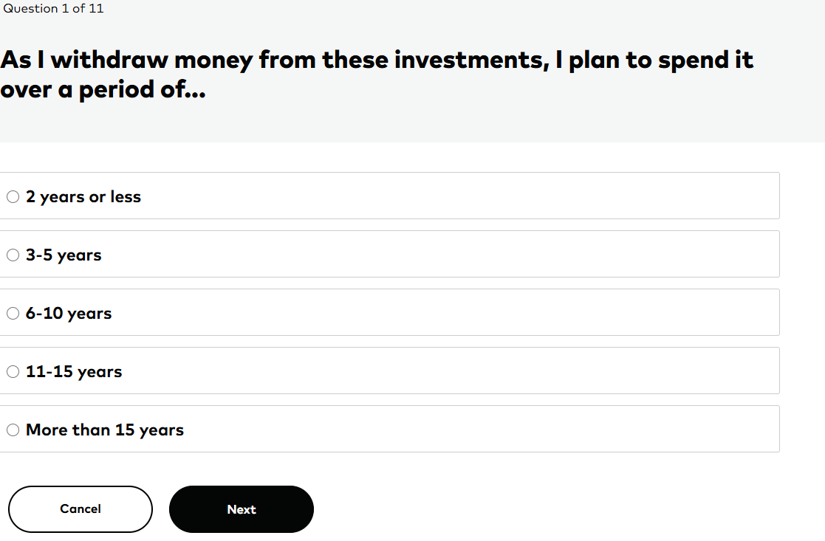


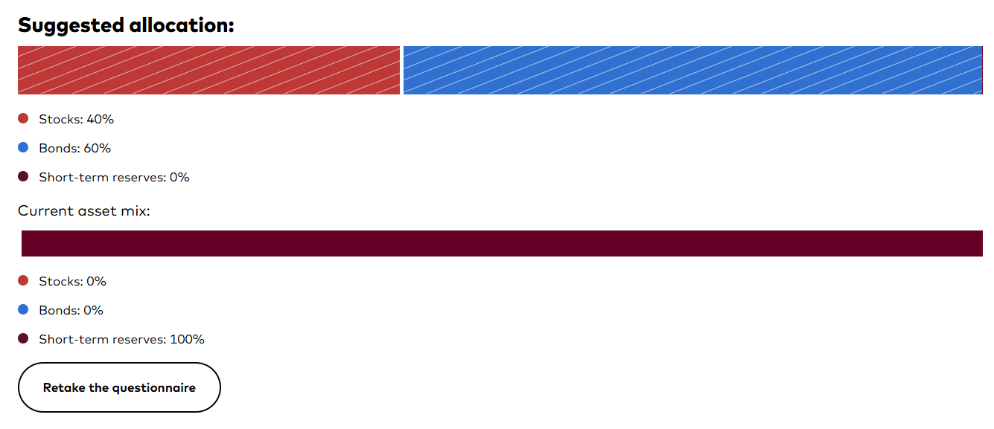
Self-Assessment Tools
Decision-Making Supports: Self-Assessment Tools
OEOs can integrate self-assessments as core decision-making supports, turning them into powerful tools that can guide and empower DIY investors
Before Proposed Guidance
After Proposed Guidance
Enabling Conditions
Regulatory Framework
Self-assessment tools were viewed as too closely tied to suitability obligations, which discouraged OEOs from embedding them in their platforms for fear of regulatory exposure
Guidance explicitly recognizes self-assessment as a permissible decision-making support provided that clients provide inputs themselves and appropriate safeguards are in place
  Explicit Allowance for
  Self-Assessment Tools
Implications for OEOs
OEOs could only offer generic, educational quizzes (e.g., “Learn about risk types”) that were siloed from trading platforms and not linked to investment decisions, to avoid being perceived as providing advice
OEOs can integrate self-assessment tools directly into their platforms, enabling clients to self-identify needs, goals, risk capacity, and preferences. Outputs can be linked with other decision-making supports to deliver more personalized experiences
What does the Proposed Guidance say about Self-Assessment Tools?
Explicitly recognized as a decision-making support, it may be used to help investors evaluate their own goals, risk tolerance, capacity, and preferences, provided that all inputs are supplied by the client, the OEO does not endorse any specific investment decision, and appropriate safeguards such as clear disclosures and conflict of interest management are applied.
Case Study
Investor Questionnaire: Short quiz on goals, time horizon, and risk tolerance to define an investor profile
Suggested Allocation: Returns a target stocks/bonds/cash mix with sample portfolio guidance; Vanguard account holders can see target asset mix in Account Overview

Slide 15







Finfluencers & Copy Trading
Decision-Making Supports: Finfluencers & Copy Trading
OEOs should refrain from hosting finfluencer content unless it is vetted, from registered sources, and clearly disclosed, and avoid offering copy-trading feature on their platform altogether
  Risks from Finfluencers
  Risks from Copy Trading
Enabling Conditions
Unregistered Individuals
Only 13% of influencers had the relevant qualifications and credentials to advise on finance matters¹
Enforcement Action: In June 2025, the FCA led a global crackdown on illegal influencers, resulting in 3 arrests, 7 cease-and-desist letters, and 650+ take-down requests
Inherited Finfluencer Risks
All risks associated with finfluencers extend to copy trading, as the feature enables investors to directly follow and execute finfluencers’ recommendations; as such, customer copy trading complaints received by global regulators are often treated as issues of investment advice
  Narrower Definition of
  ‘Recommendation’
What does the Proposed Guidance say about Finfluencers & Copy Trading?
“OEO Dealers must consider whether they could be making prohibited recommendations or facilitating registerable activity by unregistered others (such as finfluencers) if they link to, host or provide third-party content, enter into referral arrangements or facilitate copy-trading functionality.”
Misleading Advice
71% of financial advice consumed by Gen Z and Millennials is misleading¹
Enforcement Action: In March 2024, M1 Finance was fined $850K by FINRA for failing to supervise 1,700 influencers whose posts included exaggerated or false claims
Herding Behaviour
An OSC study³ shows investors who were given the option to copy a ‘high performing’ user traded 18% more in promoted stocks, likely leading to under-diversification and excessive risk-taking
Market Manipulation
Investment scam losses in the U.S. doubled between 2021 and 2022 to $3.8B, with many originating on social media²
Enforcement Action: In December 2022, the SEC charged 8 influencers with running a $100M pump-and-dump scheme by coordinating posts on X and Discord
Followers’ Lack of Understanding
Users often choose lead traders to copy based on credentials or popularity, not actual performance or risk,⁴ which may result in investors copying unsuitable or risky strategies without proper assessment
Sources: 1. Social Capital Markets 2025 Report; 2. Federal Trade Commission (FTC): A Scammy Snapshot of 2022; 3. Ontario Securities Commission (OSC): Gamification Revisited – New Experimental Findings in Retail Investing; 4. Determinants of Leadership in Online Social Trading (Kromidha & Li, 2019)

Slide 16





Orchestrated Journey: Combining Decision-Making Supports
The Proposed Guidance empowers OEOs to design end-to-end, guided investor journeys that fulfill all DIY investing needs on their platform
Before Proposed Guidance:
Meet Sallie!
Age: 32
Location: Toronto
Profile: Marketing professional, mid-career
Investor Type: Emerging mass affluent, new to investing
Goals: Saving for her first home purchase and retirement
Approach: Digitally savvy, prefers self-directed investing to keep costs low
Challenge: Limited financial knowledge, unsure how to set goals or manage risks
Education & Research
Sallie turns to social media and finfluencers for guidance, but the information she finds
is often exaggerated, biased, or misleading
Sallie has no structured way to assess her risk tolerance or set clear goals, so she makes guesses that may not align with her needs
Sallie builds her portfolio security by security with little framework for sufficient diversification
Rebalancing is manual and effort-intensive, so Sallie avoids it, leading to portfolio drift and unintended risk exposures
Sallie receives no alerts when her cash deposits sit idle or when market events affect her holdings
Portfolio Construction
Based on her self-assessment results, Sallie selects an appropriate asset allocation through sample portfolios and uses filtering tools to choose securities that provide the right exposures
Self-Assessment
Sallie uses self-assessment tools to set her financial goals and determine her investor profile, including risk tolerance, investing experience, and time horizon
Portfolio Maintenance
Sallie uses rebalancing tools to pre-populate trades that she can execute to keep her portfolio aligned with her target allocations
Ongoing Monitoring
Sallie configures and receives alerts and notifications that flag idle cash and highlight market events relevant to her portfolio
Education & Research
Sallie learns through trustworthy, high-quality educational information embedded in the OEO platform, giving her reliable insights at every step of her investing journey
After Proposed Guidance:

Slide 17

Safeguards
While the Proposed Guidance does not represent a major shift in required safeguards, it is important for OEOs to maintain appropriate safeguards when deploying additional decision-making supports
Key Safeguards
Strengthen
Disclosures
Apply Objective
Criteria
Manage Conflicts
of Interest
Monitor and
Update Regularly
Reinforce Investor Education
Implications
  Ensuring Clarity of Boundaries
  OEOs must be mindful of the distinctions between permitted supports and prohibited recommendations, as well as the combined use of supports
  Building on Existing Controls
  Types of safeguards remain largely similar – disclosures, objective criteria, conflict of interest management, ongoing monitoring, and education
  Oversight of Finfluencer-Led Models
  These models carry elevated risks; OEOs must apply strict controls to avoid facilitating unregistered advice or recommendation-like activity
  Increased Confidence
  to Scale
  With increased certainty regarding safeguards, OEOs have more confidence to innovate responsibly and implement changes strategically
Caveat: Artificial Intelligence
  While the Proposed Guidance does not explicitly reference AI, its approach is flexible enough to allow OEOs to integrate AI-enabled tools into their platforms. However, because AI introduces significant risks, such as bias, model drift, and hallucinations, firms must apply an additional layer of safeguards, including explainability, human oversight, and extensive testing before rolling out any AI-driven supports

Slide 18
4. Path Forward

Slide 19
Path Forward for OEOs
The Proposed Guidance introduces a mix of no-regret actions and strategic choices for OEOs; firms that act now and align on critical priorities will shape the market and investor expectations, while those that wait risk being left behind
To take advantage of this guidance, OEOs must…
Act on No-Regret Items
Navigate Strategic Choices
Move Early to Capture Demand
Set the tone for how the market interprets and applies the new guidance as a first-mover, shape investor expectations around what ‘good’ looks like, and capture self-directed investors eager for enhanced supports
Decide on a Clear Channel Strategy
Make deliberate choices about service offerings across OEO, robo, and branch channels, ensuring internal alignment to minimize cannibalization and reinforce a clear, differentiated value proposition for each
Raise the Bar on Investor Experience
Deploy CIRO-approved decision-making supports (e.g., alerts, tools, sample portfolios), prioritizing those that drive client engagement, deepen investor trust, and serve as points of differentiation in a crowded market
Evaluate Monetization Strategies
Assess whether to bundle these supports as standard, free features or offer them as premium, paid options, taking into account the impact on client engagement and business objectives
Strengthen Disclosures and Guardrails
Refine investor communications and reinforce compliance boundaries to ensure tools serve as mechanisms of ‘support’ rather than ‘advice’
Align on Approach to Finfluencers & Copy Trading
Determine if and how to engage with these topics, weighing potential for client acquisition and engagement against significant regulatory, reputational, and investor protection risks
Manage Emerging Risks
First-mover advantage and associated benefits (e.g., client acquisition) will be time-bound, and sustained competitive differentiation will be challenging as competitors copy features
Overbuilt or poorly designed supports risk breaching the advice boundary, especially if there is lack of continued monitoring
Generic nudges or tools delivered in isolation without being integrated into a cohesive, well-designed client journey risk failing to deliver meaningful value, leading to investor skepticism

Slide 20
Deloitte refers to one or more of Deloitte Touche Tohmatsu Limited (DTTL), its global network of member firms, and their related entities (collectively, the "Deloitte organization"). DTTL (also referred to as "Deloitte Global") and each of its member firms and related entities are legally separate and independent entities, which cannot obligate or bind each other in respect of third parties. DTTL and each DTTL member firm and related entity is liable only for its own acts and omissions, and not those of each other. DTTL does not provide services to clients. Please see www.deloitte.com/about to learn more.
This communication and any attachment to it is for internal distribution among personnel of Deloitte Touche Tohmatsu Limited (DTTL), its global network of member firms and their related entities (collectively, the "Deloitte organization"). It may contain confidential information and is intended solely for the use of the individual or entity to whom it is addressed. If you are not the intended recipient, please notify us immediately, do not use this communication in any way and then delete it and all copies of it on your system.
None of DTTL, its member firms, related entities, employees or agents shall be responsible for any loss or damage whatsoever arising directly or indirectly in connection with any person relying on this communication.
© 2025. For information, contact Deloitte Touche Tohmatsu Limited.

